Slide 1
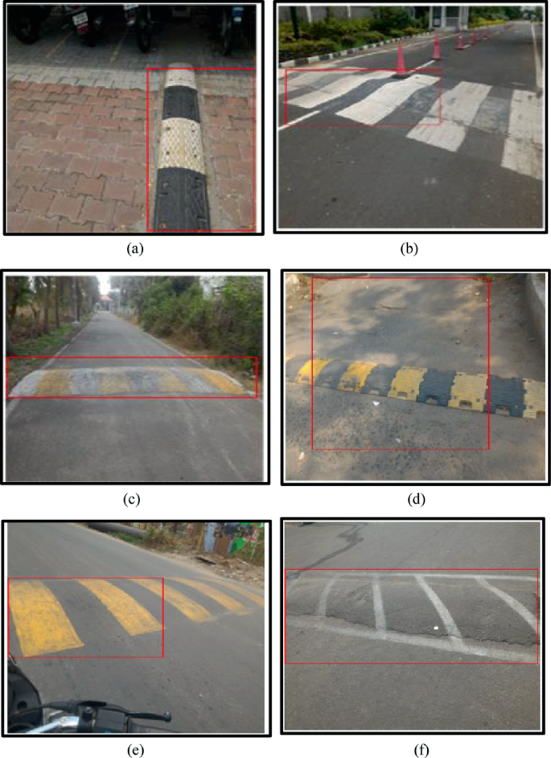
Speed Breaker & Pothole Detection Using Computer Vision
Ayush Kumar
LJMU MS in Data Science

Slide 2
Content
Introduction & Background
Literature Review
Problem Statement & Objectives
Research Methodology
Results & Discussion
Conclusion & Future Work
This Presentation Walks Through Our Complete Detection Pipeline

Slide 3
Introduction – The Problem
Potholes and Speed Breakers - Cause of Deaths
4400 Accidents in 2022
Non-Compliant Potholes & Speed Breakers -Of Varying Sizes & Shapes can be Found all over India without Proper Markings/ Signs
Road Safety Crisis in India
Critical for ADAS (Advanced Driver Assistance Systems)
Essential for GIS-based road mapping
Foundation for autonomous vehicle safety
Why This Matters:
This Presentation Walks Through Our Complete Detection Pipeline

Slide 4
Problem Statement
Detection Challenges:
Goal: Develop robust ML/CV models that detect anomalies across diverse conditions
This Presentation Walks Through Our Complete Detection Pipeline
Challenge Category | Specific Issues
Physical Variations | Varying sizes, shapes, non-standard construction
Environmental | Rain, poor lighting, fog, varying weather
Technical | Camera quality, sensor accuracy, computational limits
Visual Noise | Redundant information, contamination in street images

Slide 5
Research Objectives
Preprocessing: Implement techniques to enhance image quality and handle varying lighting/weather
Model Development: Design and implement multiple deep learning architectures (YOLO, Faster R-CNN, SSD)
Robustness Testing: Evaluate performance under adverse environmental conditions
Optimization: Identify optimal model(s) balancing accuracy, recall, and precision
In Scope:
Image-based detection
Adverse environmental conditions (lighting, road surface)
ML/DL model development & comparison
Metrics: Accuracy, Precision, Recall, F1-score
This Presentation Walks Through Our Complete Detection Pipeline

Slide 6
Literature Review - Evolution
This Presentation Walks Through Our Complete Detection Pipeline
Pre-2010: Sensor Based
2010-2015: Image Preprocessing
2015+: Deep Learning
Accelerometers
Threshold Methods
High False Positives
Gaussian Filtering
Edge Detection
Manual Features
CNN, YOLO, RNN
Transfer Learning
GPS Integration
Key Insight: Earlier research lacked robustness in challenging conditions (night, fog, rain)

Slide 7
Literature Review – Key Findings
G
Gap Identified: Need for robust detection under varying illumination and weather
This Presentation Walks Through Our Complete Detection Pipeline
Approach | Authors | Method | Limitation
Sensor-Based | Mohan et al., 2008 | Accelerometer thresholds | High false positives
Image Processing | Devapriya et al., 2016 | Gaussian + median filtering | Limited robustness
Deep Learning | Asad et al., 2022 | YOLOv4, YOLOv5 | Up to 95% accuracy
CNN Classification | Shah & Deshmukh, 2019 | ResNet-50 | 88.9% true positive rate

Slide 8
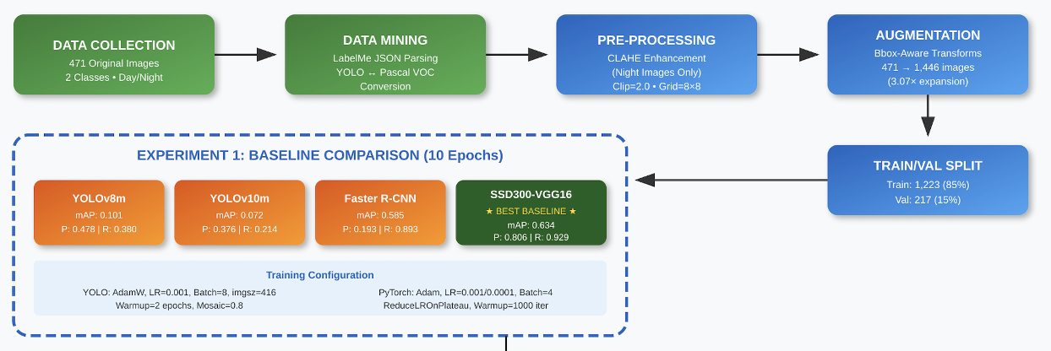
Research Methodology – Pipeline
This Presentation Walks Through Our Complete Detection Pipeline

Slide 9
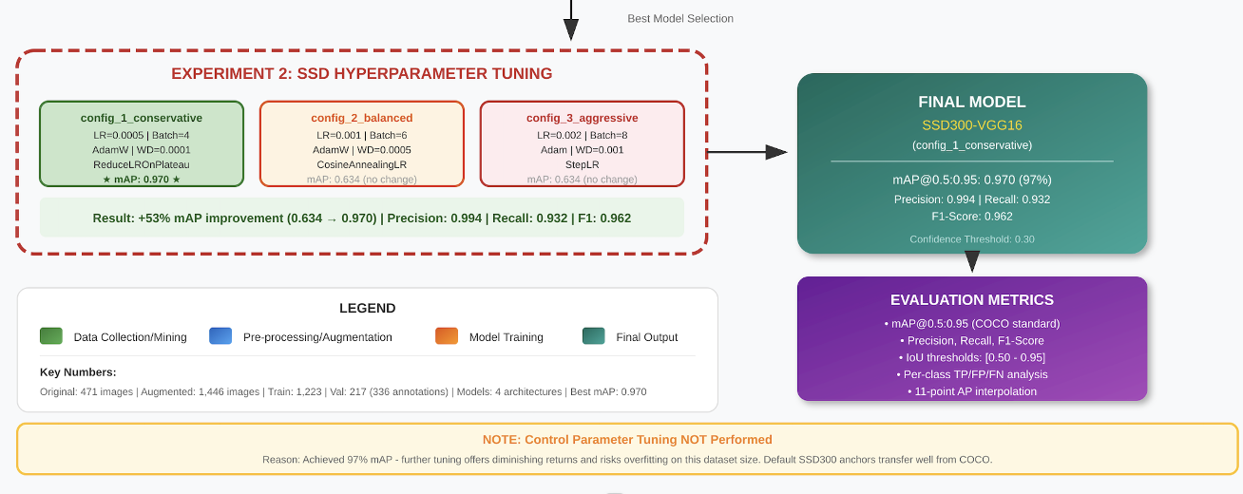
Research Methodology – Pipeline. (Continued….)
This Presentation Walks Through Our Complete Detection Pipeline

Slide 10
Dataset Description
Source: Kaggle-sourced images
Characteristics:
Captured from iPhone 12 & Vivo devices
Multiple angles: center, right, left
Includes unmarked speed breakers
This Presentation Walks Through Our Complete Detection Pipeline
Category | Original | Post-Augmentation
Potholes - Daytime | 361 | 1,073
Potholes - Nighttime | 13 | 78
Speed Breakers - Daytime | 95 | 283
Speed Breakers - Nighttime | 2 | 12
Total | 471 | 1446

Slide 11
Data Preprocessing
Lighting-Aware Enhancement:
Boost local contrast in low-light images
Limit noise amplification
Preserve bounding box alignment
Validation: Visual inspection confirms bbox alignment post-enhancement
This Presentation Walks Through Our Complete Detection Pipeline

Slide 12
Data Augmentation Strategy
Bounding-Box Preserving Transformations:
Key Principle: Introduce realistic variations a road-facing camera would encounter
Night Images: Received heavier augmentation to balance dataset distribution
This Presentation Walks Through Our Complete Detection Pipeline
Transform Type | Operations
Photometric | Brightness/contrast shifts, color adjustments
Noise | Gentle Gaussian noise
Blur | Motion blur simulation
Enhancement | Sharpening

Slide 13
Model Architectures
Three Detector Families Evaluated:
Transfer Learning: All models initialized with pretrained weights, fine-tuned on dataset
This Presentation Walks Through Our Complete Detection Pipeline
Model | Type | Characteristics
YOLOv8/v10 | One-stage | Single-pass prediction, real-time capable
Faster R-CNN | Two-stage | Region proposals → classification, higher accuracy
SSD300-VGG16 | One-stage | Multi-scale feature maps, balanced speed/accuracy

Slide 14
Experiment 1 – Baseline Comparison
Design: 10-epoch training, consistent settings across all models
Winner: SSD300-VGG16 → Selected for hyperparameter tuning
Findings: Night scenes remain most challenging despite preprocessing
Results:
This Presentation Walks Through Our Complete Detection Pipeline
Model | mAP@0.5:0.95 | Precision | Recall | F1 | Time (min)
YOLOv8m | 0.101 | 0.478 | 0.38 | 0.424 | --
YOLOv10m | 0.072 | 0.376 | 0.214 | 0.273 | --
Faster R-CNN (MBv3-FPN) | 0.585 | 0.193 | 0.893 | 0.317 | 51.5
SSD300-VGG16 | 0.634 | 0.806 | 0.929 | 0.863 | 52.8

Slide 15
Experiment 2 – Hyperparameter Tuning
Three Configurations Tested:
Training: ~30 additional epochs with early stopping
This Presentation Walks Through Our Complete Detection Pipeline
Config | LR | Batch | Weight Decay | Optimizer | Scheduler | Conf Thresh
Conservative | 0.0005 | 4 | 0.0001 | AdamW | ReduceLROnPlateau | 0.3
Balanced | 0.001 | 6 | 0.0005 | AdamW | CosineAnnealingLR | 0.25
Aggressive | 0.002 | 8 | 0.001 | Adam | StepLR | 0.2

Slide 16
Experiment 2 – Results
Hyperparameter Tuning Outcomes:
Key Insight: Lower LR + smaller batch + AdamW + ReduceLROnPlateau = optimal
This Presentation Walks Through Our Complete Detection Pipeline
Configuration | mAP@0.5:0.95 | Δ vs Baseline | Training Time
Baseline (Exp 1) | 0.634 | -- | --
Conservative | 0.970 | +0.336 | 157.4 min
Balanced | 0.634 | +0.000 | 41.7 min
Aggressive | 0.634 | +0.000 | 36.2 min

Slide 17
Final Model Performance
SSD300-VGG16 with Conservative Configuration:
Interpretation: Optimization primarily tightened precision without sacrificing recall
This Presentation Walks Through Our Complete Detection Pipeline
Metric | Baseline | Tuned | Improvement
mAP@0.5:0.95 | 0.634 | 0.970 | +53%
Precision | 0.806 | 0.994 | +23%
Recall | 0.929 | 0.932 | ~stable
F1-Score | 0.863 | 0.962 | +11%

Slide 18
Qualitative Analysis
Visual Inspection Confirms:
✓ Fewer false speed-breaker positives in night scenes post-tuning
Persistent Challenges:
✗ Very small/oblique potholes remain difficult
✓ Tighter bounding boxes for mid-scale potholes
✓ Improved localization quality
✗ Night glare continues to cause issues
✗ Reflective paint markings
This Presentation Walks Through Our Complete Detection Pipeline

Slide 19
Practical Implications
For ADAS Deployment:
Calibrate confidence thresholds per lighting condition
Apply conservative buffers around reported detections
Consider temporal smoothing for video input
For GIS Mapping:
Use detection outputs for automated road condition surveys
Implement verification layer for high-confidence detections
Buffer zones recommended for maintenance planning
This Presentation Walks Through Our Complete Detection Pipeline

Slide 20
Limitations
Dataset Constraints:
Limited diversity (similar scenes from different angles)
Small nighttime sample size
Single geographic region (India)
Technical Limitations:
Validation-only metrics (test set for final confirmation)
No real-time deployment testing
Single-frame analysis (no temporal context)
Generalization Concerns:
Cross-scene performance unknown
Different road types not tested
This Presentation Walks Through Our Complete Detection Pipeline

Slide 21
Conclusions
Key Contributions:
Pipeline Development: End-to-end system with lighting-aware preprocessing and bbox-safe augmentation
Model Selection: Systematic comparison identifies SSD300-VGG16 as optimal for this task
Optimization: Conservative hyperparameter regime achieves 97.0% mAP with high precision
Analysis: Identified specific failure modes (night glare, reflective markings, small targets)
Final Recommendation: SSD300-VGG16 (config_1_conservative) for pothole/speed breaker detection
This Presentation Walks Through Our Complete Detection Pipeline

Slide 22
Future Work
Short-term:
Expand dataset with diverse locations, road types, marked speed breakers
Test-set validation and deployment profiling
Domain adaptation for cross-region generalization
Medium-term:
Model optimization: pruning, quantization, TensorRT/ONNX conversion
Video-based detection with temporal smoothing
Semi-supervised learning to leverage unlabeled data
Long-term:
Real-time mobile/edge deployment
Integration with ADAS systems
GPS-based road condition mapping
This Presentation Walks Through Our Complete Detection Pipeline

Slide 23
Key Takeaways
✓ Problem: 4,400+ annual accidents from road anomalies in India
✓ Solution: Deep learning-based detection using SSD300-VGG16
✓ Performance: 97.0% mAP with 99.4% precision, 93.2% recall
✓ Innovation: Lighting-aware preprocessing + bbox-safe augmentation
✓ Limitation: Dataset diversity constrains generalization
✓ Next Steps: Expand data, optimize for deployment, extend to video
This Presentation Walks Through Our Complete Detection Pipeline

